Slide 1

Machine Learning Project
Nino Orton-Clarke

Slide 2
Introduction/Brief

Slide 3
Data Importing & EDA
Once each dataset was imported exploratory data analysis (EDA) could begin.
EDA includes functions like .head(), .info() to further understand aspects of the data e.g., no. of columns/rows, no. of null values or the data types in each column.
The same functions were carried out on both datasets.
The EDA process allows us to plan/decide what processes need to be carried out before the data before it can be implemented into models.

Slide 4
Data Cleansing
Only the airplane crashes dataset required data cleansing, consisting of multiple processes as there were various issues with the data.
Columns with thousands of nulls were dropped – e.g., ‘Flight #’ had 4199 null values.
‘Date’ column was split into ‘Year’, ‘Month’, ‘Day’.
Remaining nulls were dropped using dropna(inplace = True).

Slide 5
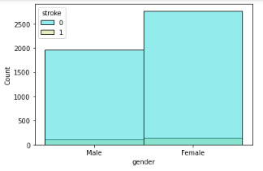
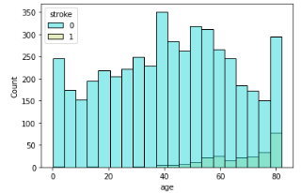
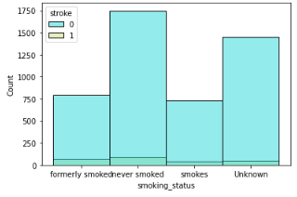
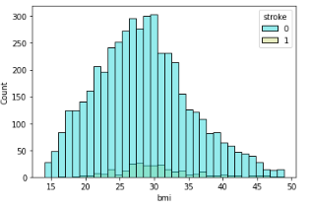
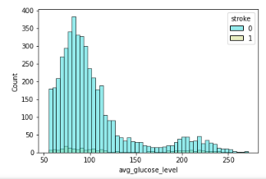
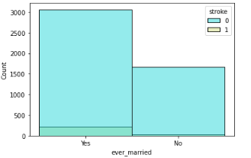
Visualizations Sample
Brain Stroke Data
Fig 1: Histplot of Stroke/Gender
Fig 2: Histplot of Stroke/Age
Fig 3: Histplot of Stroke/Smoking Status
Fig 4: Histplot of Stroke/BMI
Fig 5: Histplot of Stroke/Marital Status
Fig 6: Histplot of Stroke/Av Glucose Level

Slide 6
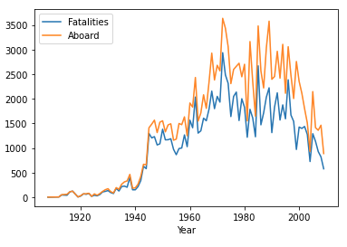
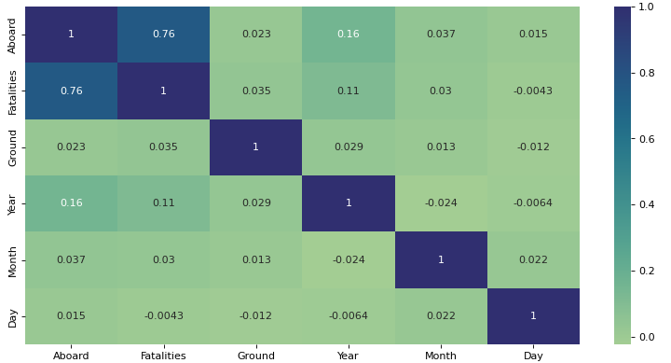
Visualizations Sample
Airplane Crash Data
Fig 7: Line Graph of Fatalities & Aboard/Year.
Fig 8: Heatmap of correlation between variables.

Slide 7
Label/One Hot Encoding
Label/one hot encoding was used on both datasets - categorical data could be transformed into numerical data so the dataset could be normalized.
Brain Stroke Dataset – ‘Gender’, ‘Ever married’, ‘Work type’, ‘Residence Type’ and ‘Smoking type’ were all encoded.
Airplane Crash Dataset – Only ‘Date’, ‘Location’ and ‘Operator’ were encoded.

Slide 8
Normalisation & Undersampling
Both datasets were normalised using the MinMaxScaler(), converting all values within the respective dataset to a value between 0 and 1.
For the brain stroke data only undersampling was required due to the disparity in class distribution within the dataset.
This improves the prediction/evaluation accuracy of models.

Slide 9
Classification Models
Before creating an instance of any model, the data must be split into X and y variables.
‘y’ variable being the target variable.
Data is then trained using train test split.
Models are then fitted to the train data in order to produce predictions within a classification report and confusion matrix.

Slide 10
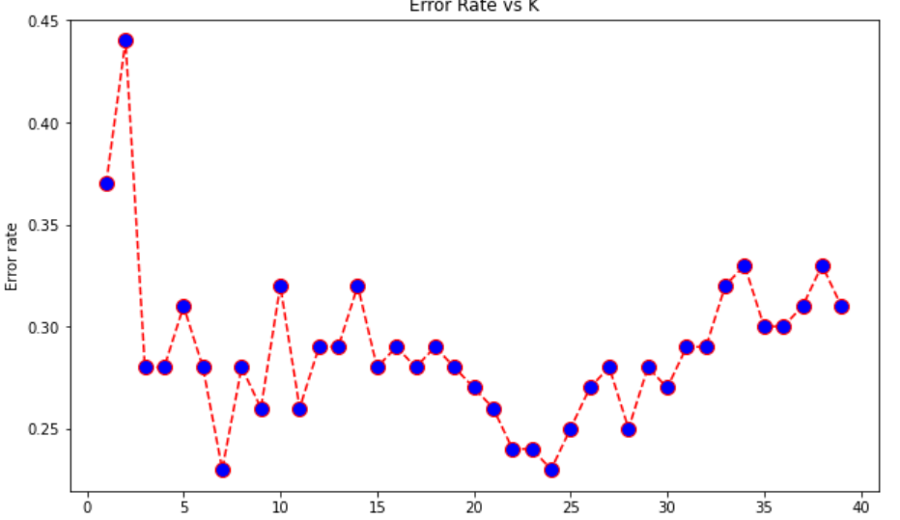
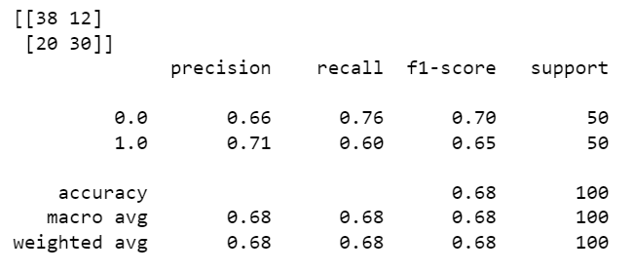
Classification Model 1 – KNN Results
KNN model produced the classification report and confusion matrix seen in fig 9.
Looking at the confusion matrix we can see there is a total of 32 false predictions and 69 true predictions.
Classification report would suggest that the model had ~70% accuracy in prediction.
Scores ranged between 0.65 and 0.76, with the majority being the mid to late 60s.
The K- value used for this model was 10, however the optimal K-value displayed by fig 10 is 7.
Fig 9: KNN classification report and confusion matrix
Fig 10: KNN error rate vs K graph

Slide 11
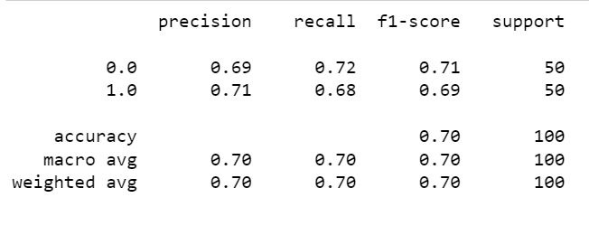
Classification Model 2 – Dtree Results

